Slide 1
Analysis of Head Start Accessibility
Group : Dataminers
Member: Zizheng (Sean) Zhang
Yinming (Randall) Gao
Notes:
Good afternoon everyone! Today, we, the Dataminers, are excited to present our analysis of Head Start accessibility. Let me introduce our team members: Zizheng (Sean) Zhang and Yinming (Randall) Gao.

Slide 2
Agenda
Background
Technologies In-use
Major Findings
Major Insights
One More Thing
Notes:
Let's quickly walk through our agenda for today. We will cover the background of Head Start, the technologies we utilized, our major findings and insights, and a special feature we've developed.

Slide 3
Background
Established in 1965, Head Start promotes school readiness for children in low-income families by offering educational, nutritional, health, social, and other services. The program is rooted in urban, suburban, and rural communities throughout the nation.
Notes:
Established in 1965, Head Start is a program designed to enhance school readiness among children from economically disadvantaged backgrounds. It offers a range of services from education to health, ensuring comprehensive child development.

Slide 4
Background (cont'd)
Service Mismatch: Only 30% of 3-to-5-year-olds and 9% of infants in poverty were served by Head Start.
COVID-19 Effect: A drop of 287,000 children in Head Start attendance in 2020-2021 compared to 2018-2019.
Funding Discrepancies: States with more child poverty receive less funding per child for Head Start.
Notes:
Despite its noble intent, there are challenges. Only a fraction of eligible children are served by Head Start, with the COVID-19 pandemic causing a further drop in attendance. Additionally, funding discrepancies exist across states.

Slide 5
Technologies In-use
Python: for data extraction, data analysis, statistical modeling, data pipeline automation, and web API development
HTML, CSS, Javascript: for web development
Tableau: for data visualization.
PowerPoint: for the presentation of insights.
Notes:
To conduct our analysis, we leveraged various technologies: Python for data handling and analysis, web technologies for development, Tableau for visualization, and of course, PowerPoint to share our findings with you.

Slide 6
Major Findings
Notes:
Let's dive deep into our primary discoveries.

Slide 7
Metrics
Center Coverage Rate (County level)
Children per Center (County level)
Enrollment Rate (State level)
Fund per Child (State level)
Notes:
These are the key metrics we've focused on to assess the program's accessibility and efficiency.
And we will interpret them one by one later.

Slide 8
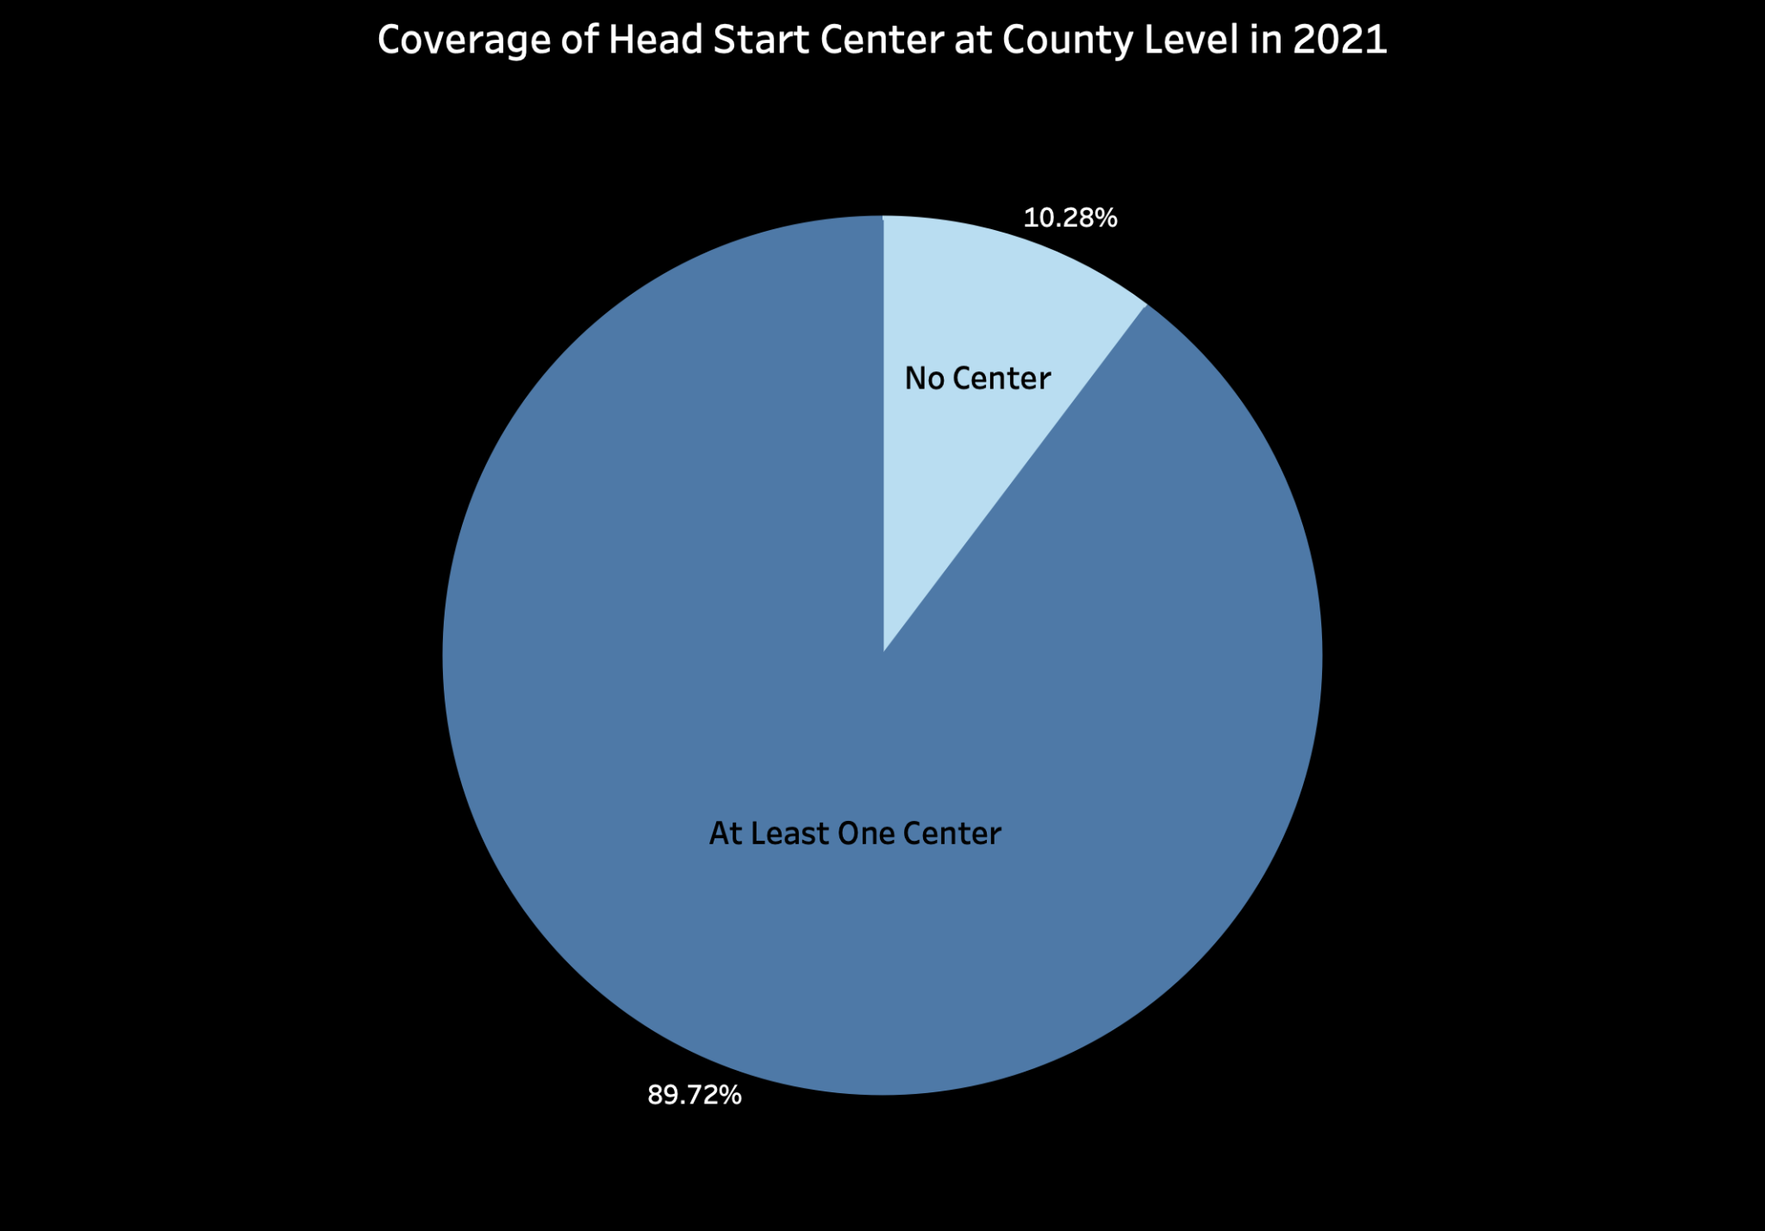
No Center: 315
At Least One Center: 2,748
Coverage Rate
= # of county with center / total # of county
Notes:
This is a pie chart showing that the counties with at least one center account for around 90%. However, there are still 315 counties without even one center, which underscores an accessibility issue.

Slide 9
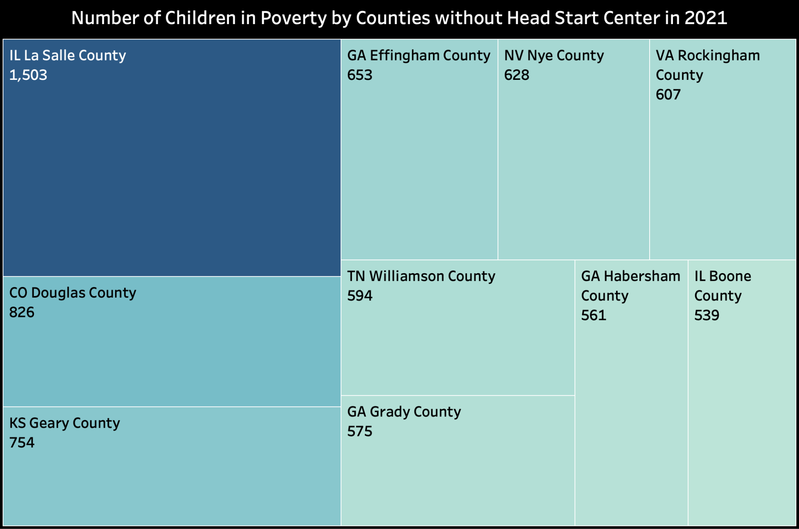
10 Counties without Head Start Center
Notes:
Here, we highlight ten counties facing significant underservice, particularly in terms of the number of children from low-income families. Typically, there are around 500 to 600 impoverished children in counties without centers. Notably, La Salle County in Illinois stands out with 1503 children living in poverty. This underscores that it’s necessary for policymakers to invest additional resources and construct more facilities to address this specific need.

Slide 10
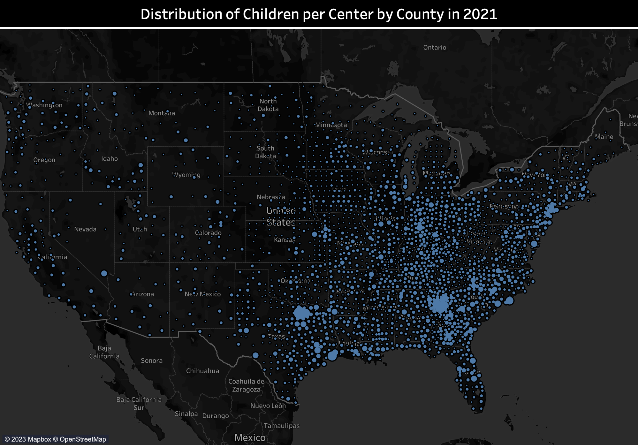
- Children/Center
- East & West
Notes:
This is a map show the distribution of Children per center by County. We used the number of impoverished children to divide the number of head start centers at each county, thereby calculating the cpc metric, which helps measure the accessibility of head start program at a county. On the map, the spot sizes are directly proportional to the CPC value. In simpler terms, larger spots on the map represent regions with a higher CPC value, indicating worse head start program accessibility. Here we can observe that the eastern part of the State appears brighter than the western part, which shows a more serious accessibility issue in the eastern part.

Slide 11
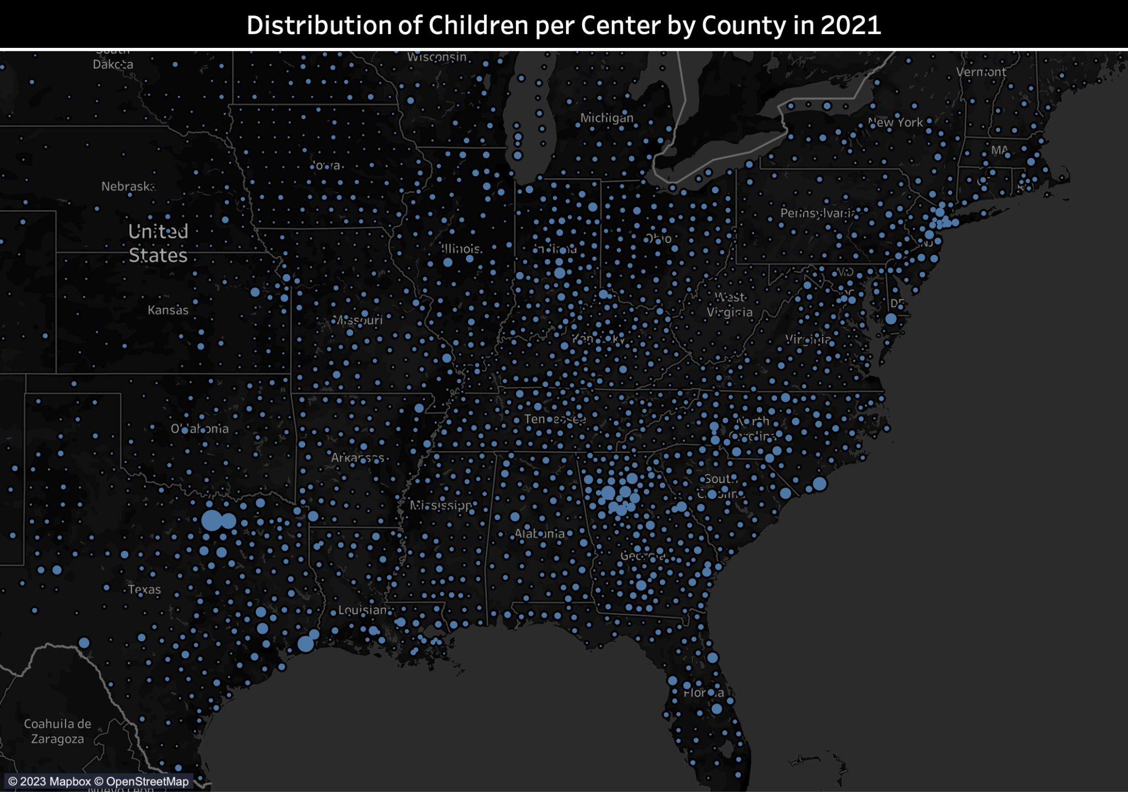
Texas & Georgia
Notes:
Now, let's focus on the eastern part of the map. In particular, both the eastern part of Texas and the entire state of Georgia exhibit larger and more densely clustered circles.

Slide 12
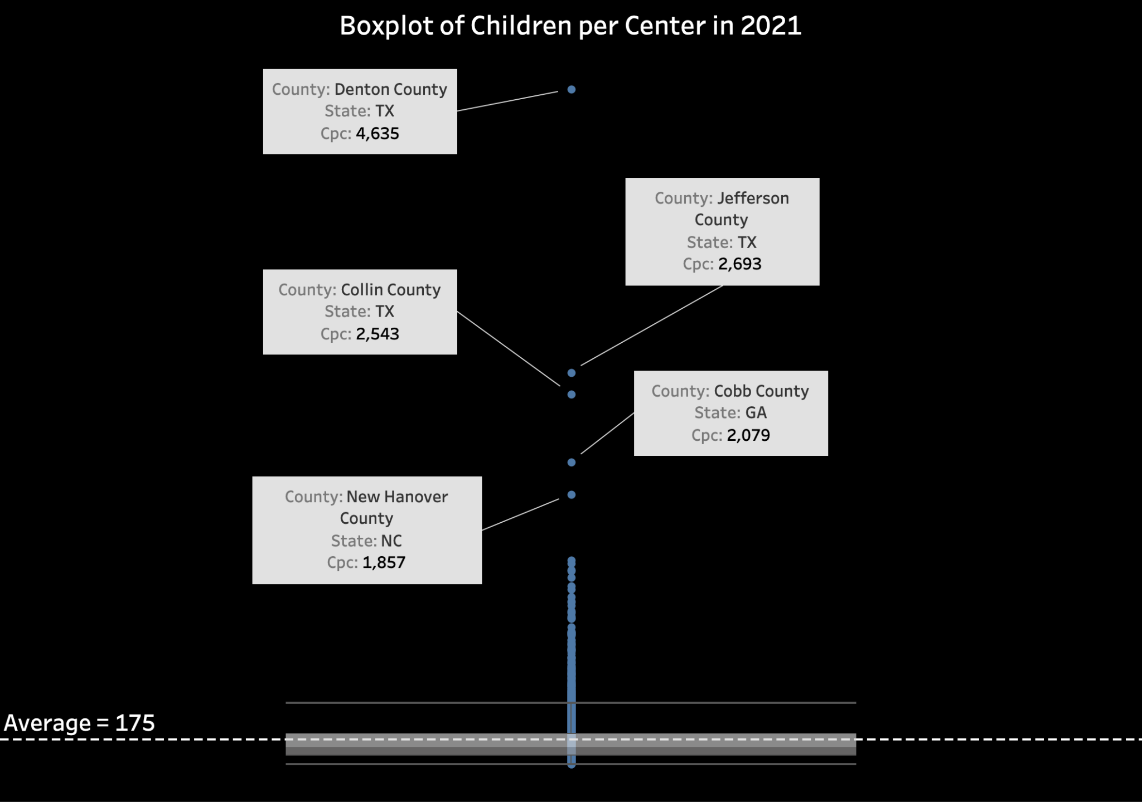
Cpc (Children per Center)
= # of children in poverty / # of center in one county
Notes:
The boxplot provides information about some of the regions mentioned in the previous slide. While the CPC levels across counties generally show similarities, there are a few outliers, such as Denton County and Jefferson County in Texas. These outliers exhibit unusually high CPC values, suggesting potential issues with accessibility to the head start program. This highlights the importance for policymakers to focus on these specific areas and consider measures to improve access.

Slide 13
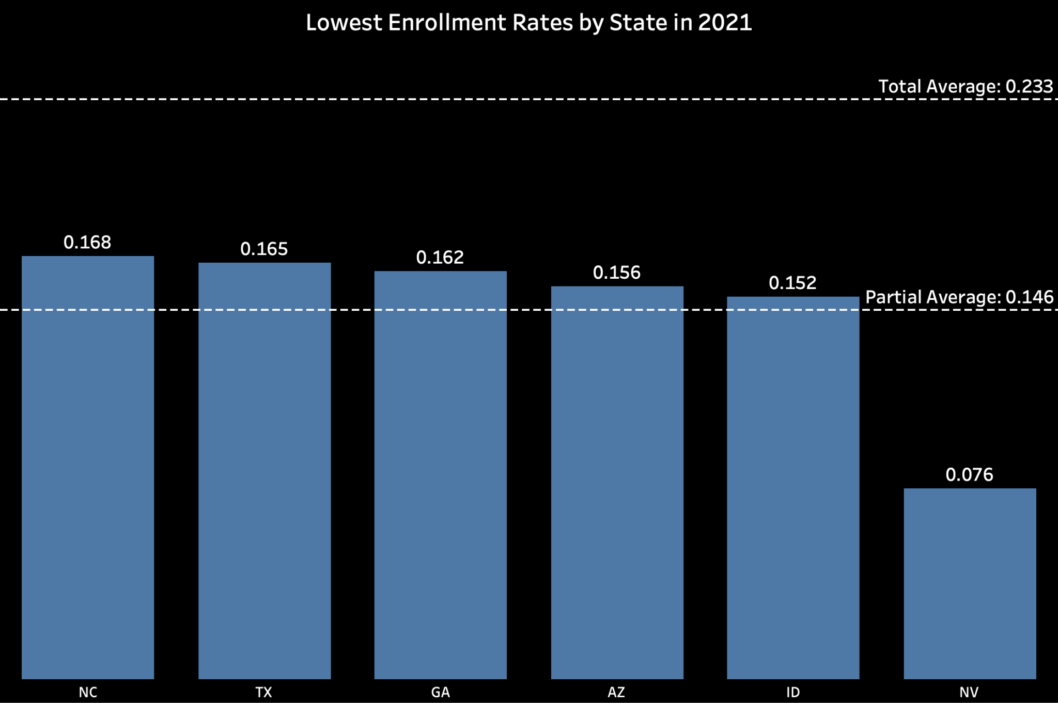
6 States with the Lowest Enrollment Rates
Enrollment Rate
= number of enrollments / estimated number of children in poverty
Notes:
Definition of enrollment rate
Usage: to measure if the head start program is well utilized in an area
48 contiguous states were analyzed
Top six with lowest enrollment rate are listed here
Low enrollment rate implies three potential issues:
Too few public exposure so that families in poverty aren’t aware of head start
There are other local policies that have taken effect such that local families dont need head start
Head start program’s quality is poor at those areas.

Slide 14
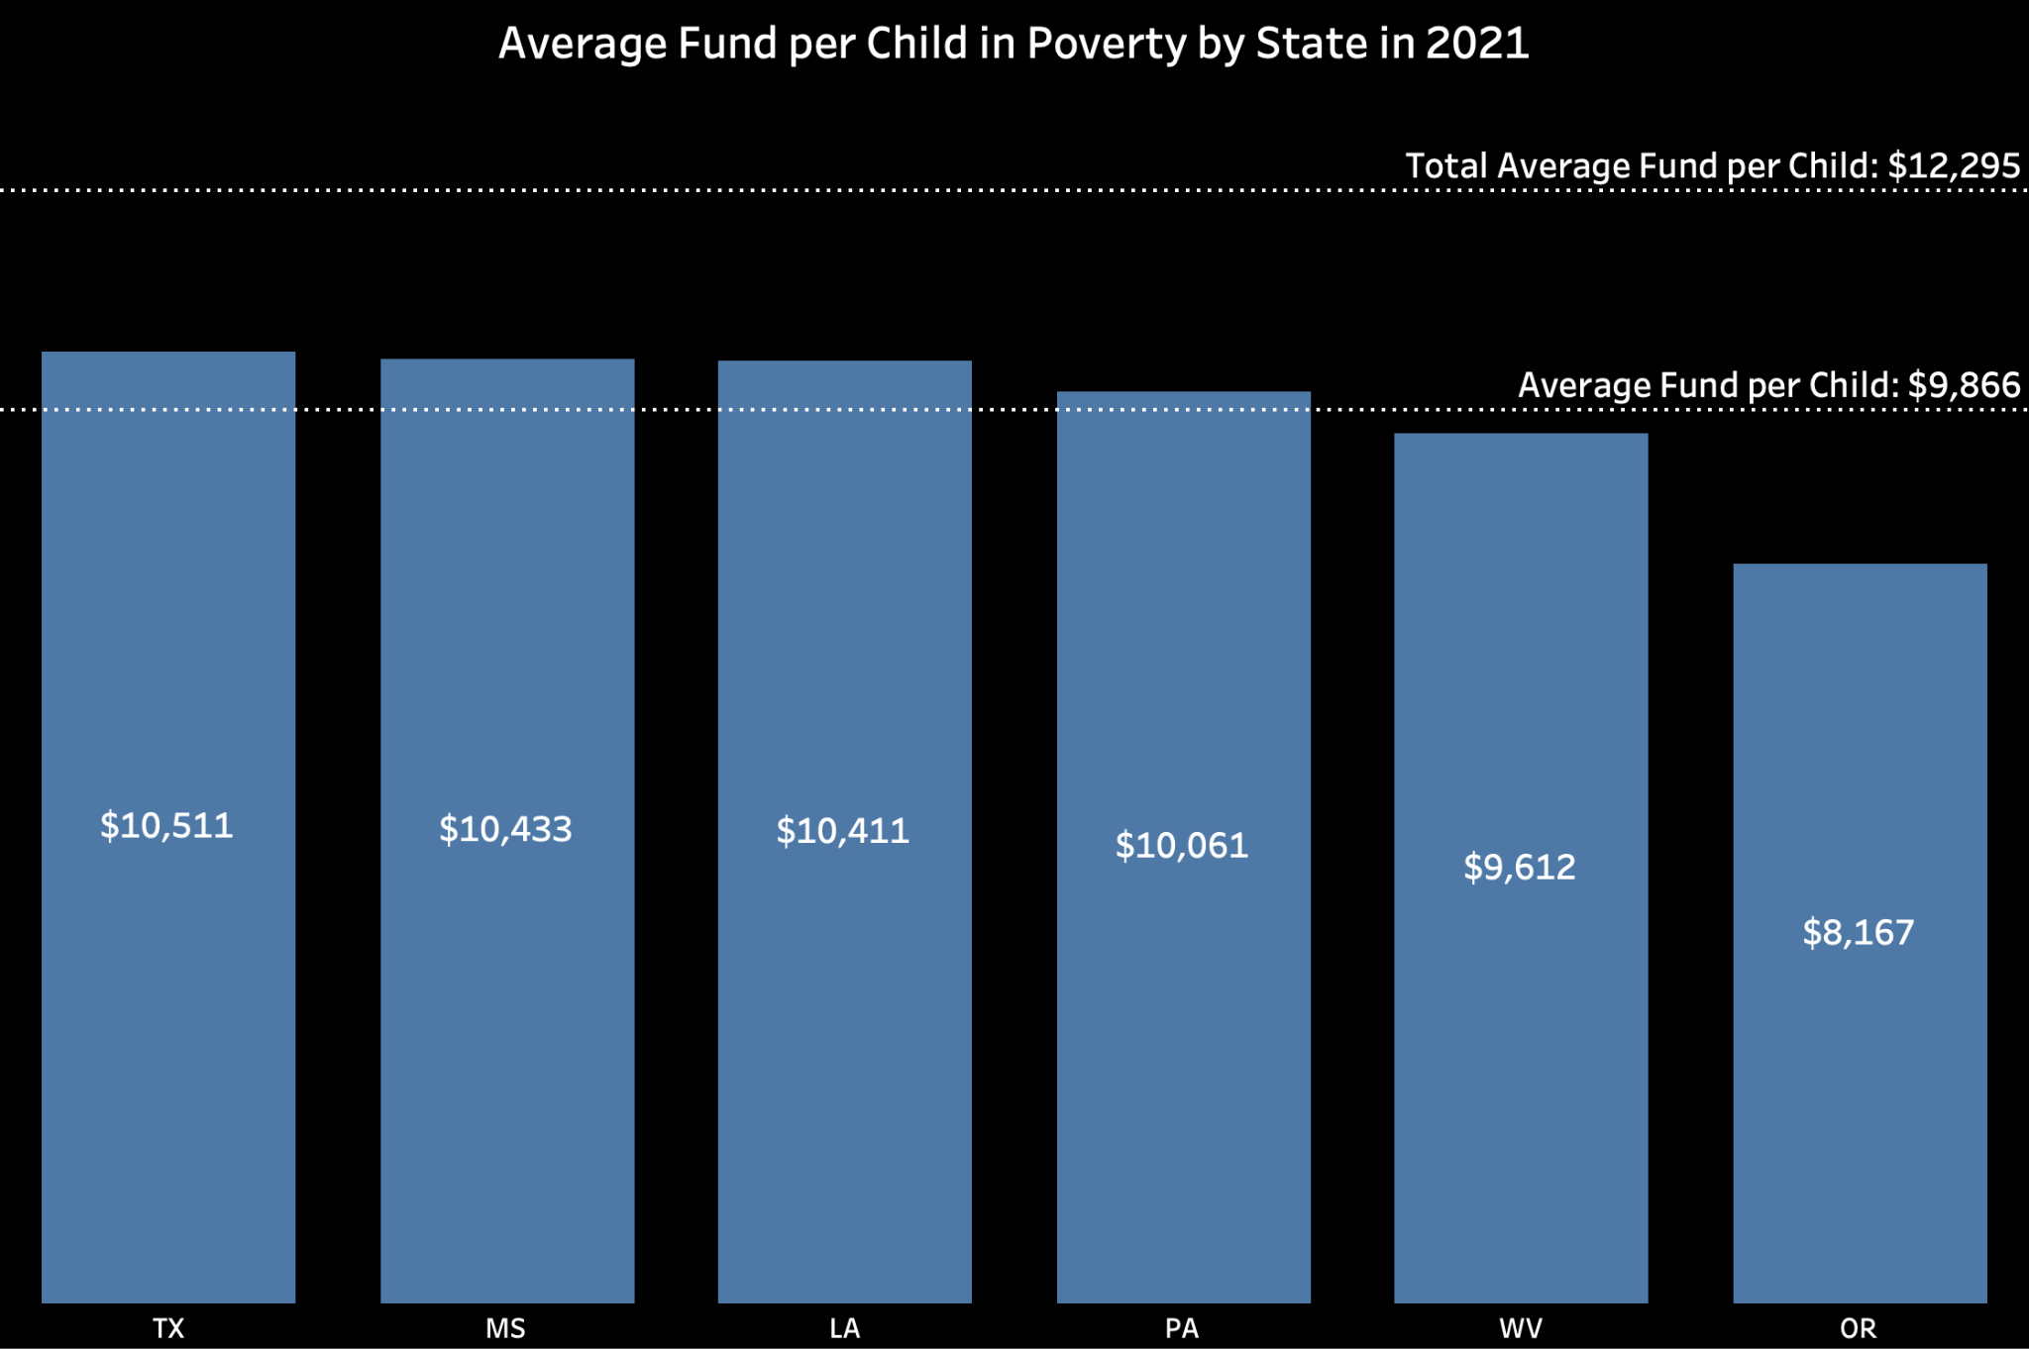
6 States with the Lowest Average Fund per Child
Fund/Enrolled Children
Notes:
Definition of fund per child: annual federal funding received divided by the number of enrollments.
Usage: measure and compare the fiscal support given to each region.

Slide 15
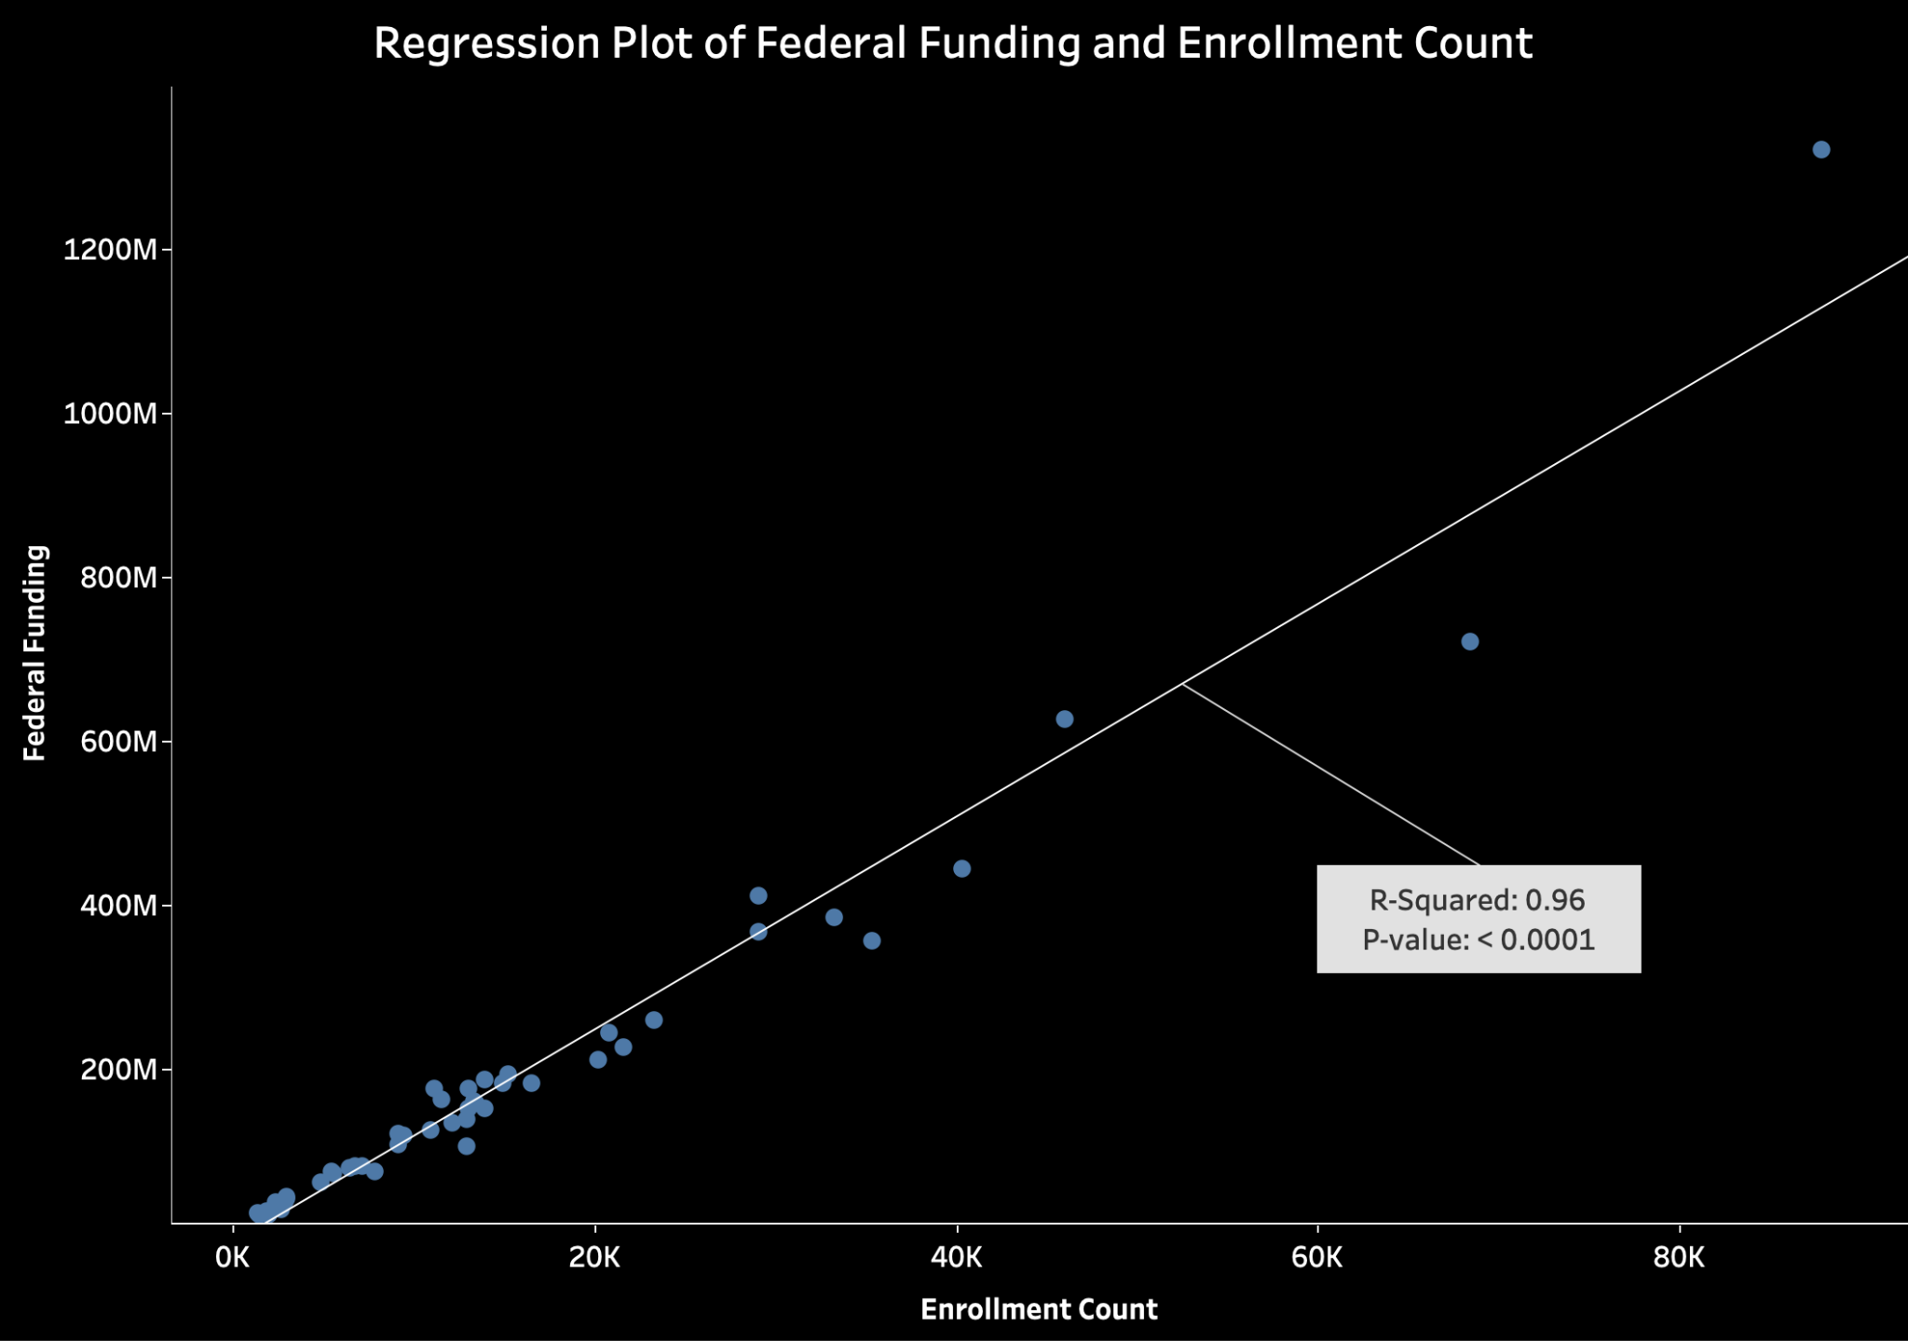
Notes:
Econometric study: the relationship between funding and enrollment count
Conclusion: funding policy is reasonable in that it is roughly proportional to enrollment

Slide 16
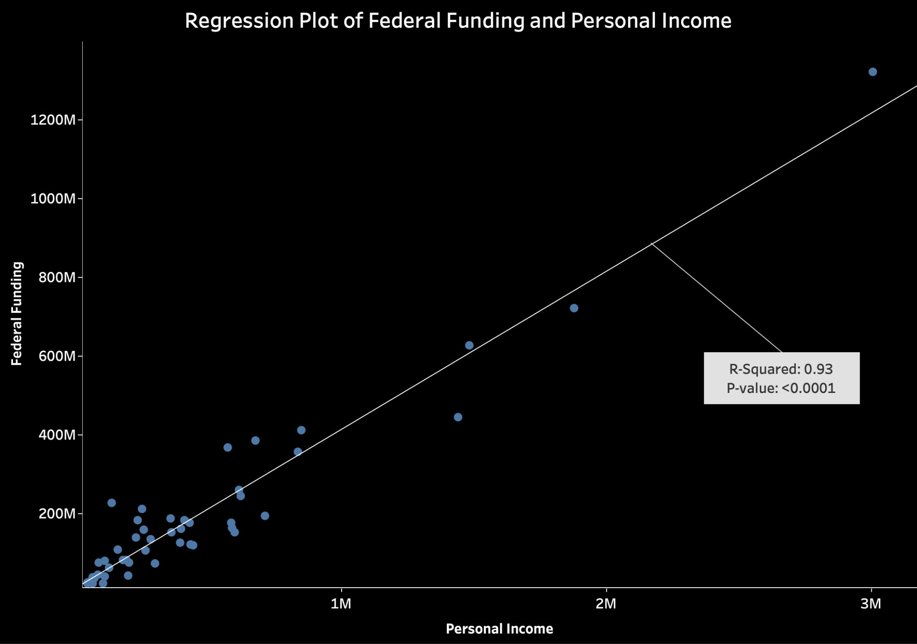
Notes:
Econometric study: the relationship between funding and personal income
Conclusion: funding policy is reasonable in that it is roughly proportional to local economy standard.

Slide 17
Major Insights
Notes:
dsa

Slide 18
Major Insights - Public Policy
There are clusters of counties in TX and GA where local communities may be underserved by Head Start. Policy makers may need to find more Head Start participants in those areas so as to facilitate the accessibility of Head Start.
Nevada, Idaho, Arizona, Georgia, and Texas are the states with the lowest estimated enrollment rate, meaning that the communities in these five states are likely underserved. Policy makers may need to increase public exposure to Head Start, especially to low-income families, so that low-income families are aware of Head Start and begin enrolling in Head Start.
The funding policy of Head Start is well adapted to local economic and demographic situation.

Slide 19
Major Insights - Technology Innovation
In many cases, plain data are informative, but not ready to use. It is through an analytics pipeline where the raw data endures sequential processing and transformation that the underlying information and insights in the raw data become visible.
Automated analytics pipeline can remove the recurrent and repeated part of data analytics. For data of time series nature such as annually updated data, with well defined metrics and robust external data sources, the extraction, transformation, and loading of the data can be an automated process.
Notes:
In many cases, plain data are informative, but not ready to use. It is through an analytics pipeline where the raw data endures sequential processing and transformation that the underlying information and insights in the raw data become visible.
Automated analytics pipeline can remove the recurrent and repeated part of data analytics. For data of time series nature such as annually updated data, with well defined metrics and robust external data sources, the extraction, transformation, and loading of the data can be an automated process. The time series’ most recent values will be automatically updated by the pipeline itself once the dependent external data source has an update.

Slide 20
One More Thing…

Slide 21
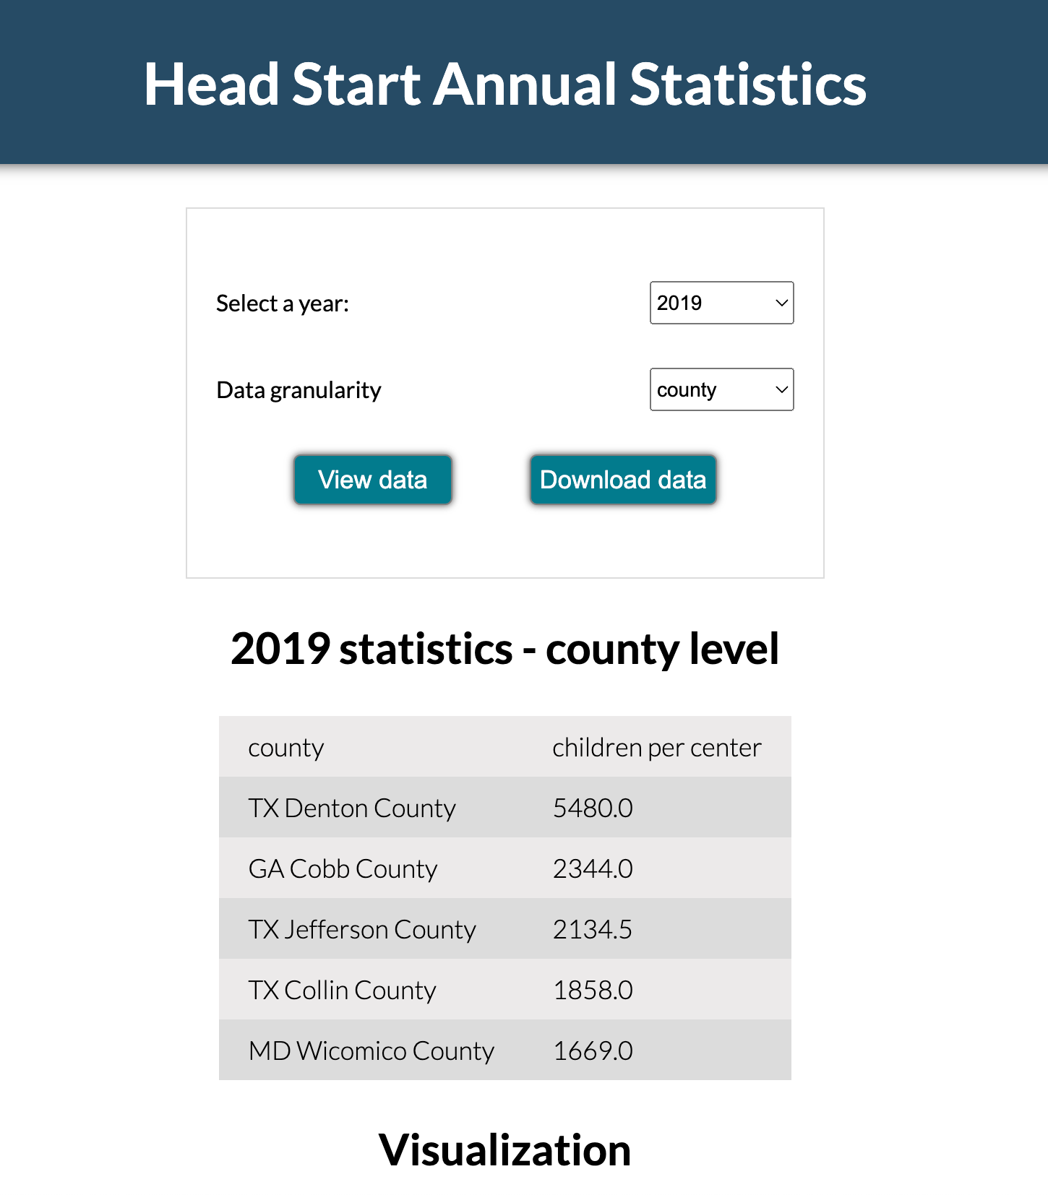
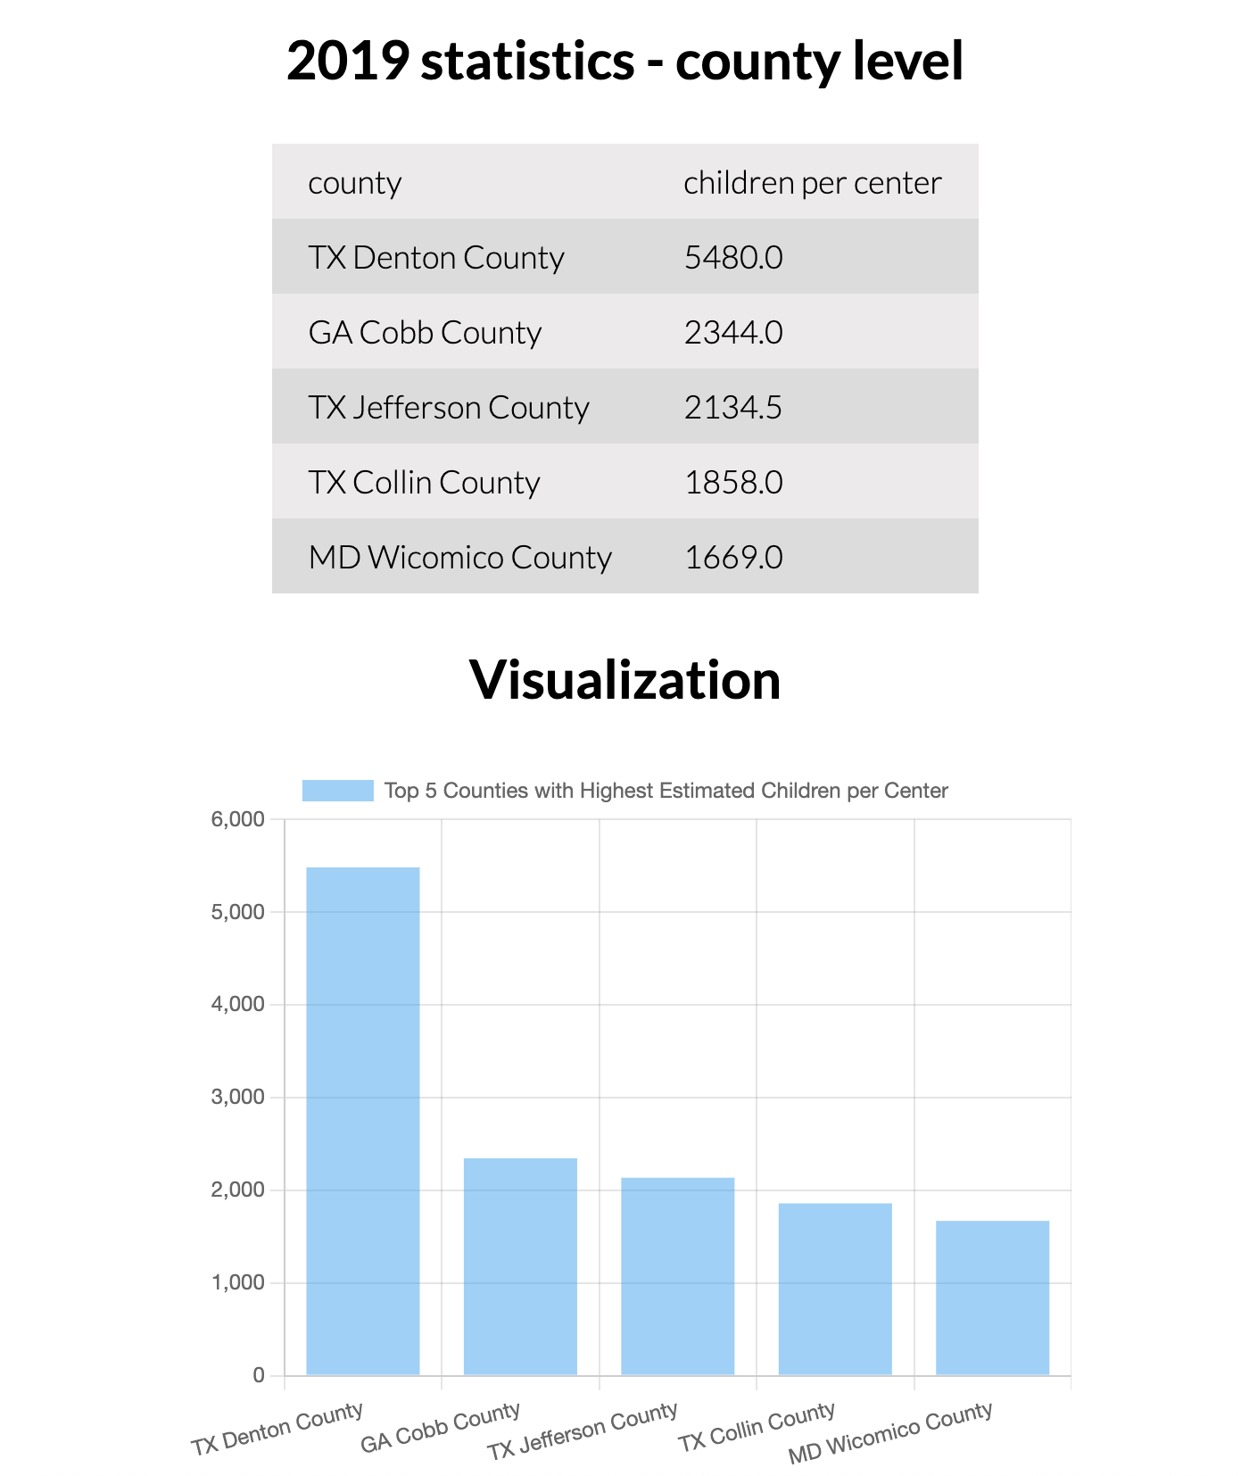
Automated Analytics Pipeline -
Analyze once, track forever
http://chaconn3.me (PC access for best experience)
Notes:
Major advantage:
Analyze once, track forever.
Applies to data of time series nature
Once the analysis of one observation is done, the analysis of previous and succeeding observations can be automated, assuming the data source remain the same format and interfacing mechanisms.
Helps reduce the laborious, recurrent, and repetitive part of analytics worf flow.
Helps data analyst to focus on analysis itself rather than data engineering.
Once an analytical approach is found useful, applies this approach/process to all the preceding or succeeding time series data.
Automatically handling data inregraiton and data transformation. Analyst will only need to interpret the metrics, without the need to do data engineering tasks repeatedly.

Slide 22
Thank You!

